Slide 1
Développement Front End JQUERY
Année 2023
Animé par : Mohammed BAHRI (Développeur et Formateur Web)

Slide 2


Slide 3
jQuery : Introduction
jQuery permet de faire beaucoup tâches javaScript avec beaucoup moins de lignes de code.
jQuery simplifie également beaucoup de choses complexes en JavaScript, comme les appels AJAX et la manipulation DOM.
La bibliothèque jQuery contient les fonctionnalités suivantes:
Manipulation HTML / DOM
Manipulation de CSS
Méthodes d'événement HTML
Effets et animations
AJAX

Slide 4
jQuery : Utilisation
<!DOCTYPE html>
<html>
<head>
<script src="https://ajax.googleapis.com/ajax/libs/jquery/3.3.1/jquery.min.js"></script>
<script>
$(document).ready(function(){
$("button").click(function(){
$("p").hide();
});
});
</script>
</head>
<body>
<p>Paragraphe 1</p>
<p>Paragraphe 2</p>
<button>Tester</button>
</body>
</html>

Slide 5
jQuery : Syntaxe de base
<!DOCTYPE html>
<html>
<head>
<script src="https://ajax.googleapis.com/ajax/libs/jquery/3.3.1/jquery.min.js"></script>
<script>
$(document).ready(function(){
$("button").click(function(){
$(this).hide();
$("p").hide();
$(".ma_classe").hide();
$("#mon_id").hide();
});
});
</script>
</head>
<body>
<p>Paragraphe 1</p>
<div class="ma_classe">Paragraphe 2</div>
<div id="mon_id">Paragraphe 3</div>
<button>Tester</button>
</body>
</html>

Slide 6
jQuery : Evénements
<!DOCTYPE html>
<html>
<head>
<script src="https://ajax.googleapis.com/ajax/libs/jquery/3.3.1/jquery.min.js"></script>
<script>
$(document).ready(function(){
$("p").on({
mouseenter: function(){ $(this).css("background-color", "lightgray");},
mouseleave: function(){ $(this).css("background-color", "lightblue");},
click: function(){ $(this).css("background-color", "yellow");}
});
});
</script>
</head>
<body>
<p>Paragraphe</p>
</body>
</html>
Notes:
<!DOCTYPE html>
<html>
<head>
<script src="https://ajax.googleapis.com/ajax/libs/jquery/3.3.1/jquery.min.js"></script>
<script>
$(document).ready(function(){
$("p").on({
mouseenter: function(){
$(this).css("background-color", "lightgray");
},
mouseleave: function(){
$(this).css("background-color", "lightblue");
},
click: function(){
$(this).css("background-color", "yellow");
}
});
});
</script>
</head>
<body>
<p>Paragraphe</p>
</body>
</html>

Slide 7
jQuery : Effets (Hide - Show)
<!DOCTYPE html>
<html>
<head>
<script src="https://ajax.googleapis.com/ajax/libs/jquery/3.3.1/jquery.min.js"></script>
<script>
$(document).ready(function(){
$("#hide").click(function(){
$("p").hide();
});
$("#show").click(function(){
$("p").show();
});
});
</script>
</head>
<body>
<p>Si vous cliquez sur le bouton "Masquer", je vais disparaître.</p>
<button id="hide">Masquer</button>
<button id="show">Montrer</button>
</body>
</html>

Slide 8
jQuery : Effets (Slide)
<!DOCTYPE html>
<html>
<head>
<script src="https://ajax.googleapis.com/ajax/libs/jquery/3.3.1/jquery.min.js"></script>
<script src="script.js"></script>
<style>
#panel, #flip {
padding: 5px;
text-align: center;
background-color: #e5eecc;
border: solid 1px #c3c3c3;
}
#panel {
padding: 50px;
display: none;
}
</style>
</head>
<body>
<div id="flip">Click to slide down panel</div>
<div id="panel">Hello world!</div>
</body>
</html>

Slide 9
jQuery : Effets (Slide)
$(document).ready(function(){
$("#flip").click(function(){
$("#panel").slideDown("slow");
});
});
/*
$(document).ready(function(){
$("#flip").click(function(){
$("#panel").slideUp("slow");
});
});
$(document).ready(function(){
$("#flip").click(function(){
$("#panel").slideToggle("slow");
});
});
*/

Slide 10
jQuery : Contenu (Get : Texte/HTML)
<!DOCTYPE html>
<html>
<head>
<script src="https://ajax.googleapis.com/ajax/libs/jquery/3.3.1/jquery.min.js"></script>
<script>
$(document).ready(function(){
$("#btn1").click(function(){
alert("Text: " + $("#test").text());
});
$("#btn2").click(function(){
alert("HTML: " + $("#test").html());
});
});
</script>
</head>
<body>
<p id="test">Ceci est un texte <b>gras</b> dans un paragraphe.</p>
<button id="btn1">TEXTE</button>
<button id="btn2">HTML</button>
</body>
</html>

Slide 11
jQuery : Contenu (Get : Valeur)
<!DOCTYPE html>
<html>
<head>
<script src="https://ajax.googleapis.com/ajax/libs/jquery/3.3.1/jquery.min.js"></script>
<script>
$(document).ready(function(){
$("button").click(function(){
alert("Value: " + $("#test").val());
});
});
</script>
</head>
<body>
<input type="text" id="test" value="Valeur teste">
<button>Montrer</button>
</body>
</html>

Slide 12
jQuery : Contenu (Get : attribut)
<!DOCTYPE html>
<html>
<head>
<script src="https://ajax.googleapis.com/ajax/libs/jquery/3.3.1/jquery.min.js"></script>
<script>
$(document).ready(function(){
$("button").click(function(){
alert($("#med").attr("href"));
});
});
</script>
</head>
<body>
<p><a href="http://bahri-mohammed.fr" id="med">Mon site web</a></p>
<button>Tester</button>
</body>
</html>

Slide 13
jQuery : Contenu (Set : Texte/HTML)
<!DOCTYPE html>
<html>
<head>
<script src="https://ajax.googleapis.com/ajax/libs/jquery/3.3.1/jquery.min.js"></script>
<script>
$(document).ready(function(){
$("#btn1").click(function(){
$("#test1").text("Bonjour!");
});
$("#btn2").click(function(){
$("#test2").html("<b>Bonjour!</b>");
});
$("#btn3").click(function(){
$("#test3").val("Mohammed BAHRI");
});
});
</script>
</head>
<body>
<p id="test1">Paragraphe 1</p>
<p id="test2">Paragraphe 2</p>
<input type="text" id="test3" value="Valeur par default">
<button id="btn1">Set Text</button>
<button id="btn2">Set HTML</button>
<button id="btn3">Set Value</button>
</body>
</html>

Slide 14
jQuery : Contenu (Set : Attribut)
<!DOCTYPE html>
<html>
<head>
<script src="https://ajax.googleapis.com/ajax/libs/jquery/3.3.1/jquery.min.js"></script>
<script>
$(document).ready(function(){
$("button").click(function(){
$("#med").attr("href", "http://bahri-mohammed.fr/jquery/");
});
});
</script>
</head>
<body>
<p><a href="http://bahri-mohammed.fr/" id="med">Mohammed.fr</a></p>
<button>Changer la veleur href</button>
</body>
</html>

Slide 15
jQuery : Contenu (Add:Append)
<!DOCTYPE html>
<html>
<head>
<script src="https://ajax.googleapis.com/ajax/libs/jquery/3.3.1/jquery.min.js"></script>
<script>
$(document).ready(function(){
$("#btn1").click(function(){
$("p").append("<b>Appended text new</b>.");
});
$("#btn2").click(function(){
$("ol").append("<li>List item new</li>");
});
});
</script>
</head>
<body>
<p>This is a paragraph.</p>
<ol>
<li>List item</li>
</ol>
<button id="btn1">Append text</button>
<button id="btn2">Append list items</button>
</body>
</html>

Slide 16
jQuery : Contenu (Add:Prepend)
<!DOCTYPE html>
<html>
<head>
<script src="https://ajax.googleapis.com/ajax/libs/jquery/3.3.1/jquery.min.js"></script>
<script>
$(document).ready(function(){
$("#btn1").click(function(){
$("p").prepend("<b>Prepended text</b>.");
});
$("#btn2").click(function(){
$("ol").prepend("<li>Prepended item</li>");
});
});
</script>
</head>
<body>
<p>This is a paragraph.</p>
<ol>
<li>List item 1</li>
</ol>
<button id="btn1">Prepend text</button>
<button id="btn2">Prepend list item</button>
</body>
</html>

Slide 17
jQuery : Contenu (Add: Before/After)
<!DOCTYPE html>
<html>
<head>
<script src="https://ajax.googleapis.com/ajax/libs/jquery/3.3.1/jquery.min.js"></script>
<script>
$(document).ready(function(){
$("#btn1").click(function(){
$("p").before("<h1>Before</h1>");
});
$("#btn2").click(function(){
$("p").after("<i>After</i><br>");
});
});
</script>
</head>
<body>
<p>Paragraphe...</p>
<button id="btn1">Insert before</button>
<button id="btn2">Insert after</button>
</body>
</html>

Slide 18
jQuery : Contenu (Remove)
<!DOCTYPE html>
<html>
<head>
<script src="https://ajax.googleapis.com/ajax/libs/jquery/3.3.1/jquery.min.js"></script>
<script>
$(document).ready(function(){
$("button").click(function(){
$("#div1").remove();
});
});
</script>
</head>
<body>
<div id="div1" style="background-color:yellow;">
<p>This is a paragraph in the div.</p>
<p>This is another paragraph in the div.</p>
</div>
<br>
<button>Remove div element</button>
</body>
</html>

Slide 19
jQuery : Contenu (Empty)
<!DOCTYPE html>
<html>
<head>
<script src="https://ajax.googleapis.com/ajax/libs/jquery/3.3.1/jquery.min.js"></script>
<script>
$(document).ready(function(){
$("button").click(function(){
$("#div1").empty();
});
});
</script>
</head>
<body>
<div id="div1" style="height:100px;width:300px;background-color:yellow;">
<p>This is a paragraph in the div.</p>
<p>This is another paragraph in the div.</p>
</div>
<br>
<button>Empty the div element</button>
</body>
</html>

Slide 20
jQuery : Contenu (Class:Add)
<!DOCTYPE html>
<html>
<head>
<script src="https://ajax.googleapis.com/ajax/libs/jquery/3.3.1/jquery.min.js"></script>
<script>
$(document).ready(function(){
$("button").click(function(){
$("h1, h2").addClass("blue");
});
});
</script>
<style>
.blue { color: blue; }
</style>
</head>
<body>
<h1>Heading 1</h1>
<h2>Heading 2</h2>
<button>Add class blue</button>
</body>
</html>

Slide 21
jQuery : Contenu (Class:Remove)
<!DOCTYPE html>
<html>
<head>
<script src="https://ajax.googleapis.com/ajax/libs/jquery/3.3.1/jquery.min.js"></script>
<script>
$(document).ready(function(){
$("button").click(function(){
$("h1, h2").removeClass("blue");
});
});
</script>
<style>
.blue { color: blue; }
</style>
</head>
<body>
<h1 class="blue">Heading 1</h1>
<h2 class="blue">Heading 2</h2>
<button>Remove class blue</button>
</body>
</html>

Slide 22
jQuery : Contenu (Class:Toggle)
<!DOCTYPE html>
<html>
<head>
<script src="https://ajax.googleapis.com/ajax/libs/jquery/3.3.1/jquery.min.js"></script>
<script>
$(document).ready(function(){
$("button").click(function(){
$("h1, h2").toggleClass("blue");
});
});
</script>
<style>
.blue { color: blue; }
</style>
</head>
<body>
<h1>Heading 1</h1>
<h2>Heading 2</h2>
<button>Toggle class</button>
</body>
</html>

Slide 23
jQuery : Contenu (CSS)
<!DOCTYPE html>
<html>
<head>
<script src="https://ajax.googleapis.com/ajax/libs/jquery/3.3.1/jquery.min.js"></script>
<script>
$(document).ready(function(){
$("button").click(function(){
alert("The font size = " + $("p").css("font-size"));
});
});
</script>
</head>
<body>
<p style="font-size:20px;">This is a paragraph.</p>
<button>Return font-size of p</button>
</body>
</html>

Slide 24
jQuery : Contenu (CSS)
<!DOCTYPE html>
<html>
<head>
<script src="https://ajax.googleapis.com/ajax/libs/jquery/3.3.1/jquery.min.js"></script>
<script>
$(document).ready(function(){
$("button").click(function(){
$("p").css({"background-color":"yellow", "color":"white"});
});
});
</script>
</head>
<body>
<p style="background-color:green;">This is a paragraph.</p>
<button>Set background-color of p</button>
</body>
</html>

Slide 25
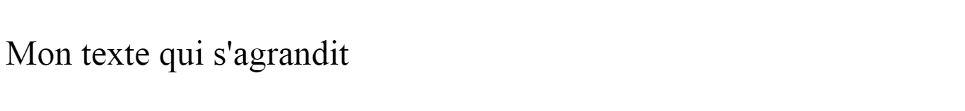

jQuery : Exercice 1
Ecrivez un texte s’agrandissant en lui cliquant dessus.
Si on reclique dessus, il reprend sa taille initiale.
Notes:
<!DOCTYPE html>
<html>
<head>
<script src="https://ajax.googleapis.com/ajax/libs/jquery/1.7.2/jquery.min.js"></script>
<script>
$(document).ready(function(){
var taillePoliceInitiale = $('p').css('fontSize');
$('p').click(function(){
if( $(this).css('fontSize') != '100px' ){
$(this).css('fontSize', '100px');
} else {
$(this).css('fontSize', taillePoliceInitiale);
}
});
});
</script>
</head>
<body>
<p style="font-size: 50px;">Mon texte qui s'agrandit</p>
</body>
</html>

Slide 26
jQuery : Corrigé 1
<!DOCTYPE html>
<html>
<head>
<script src="https://ajax.googleapis.com/ajax/libs/jquery/3.3.1/jquery.min.js"></script>
<script>
$(document).ready(function(){
var taillePoliceInitiale = $('p').css('fontSize');
$('p').click(function(){
if( $(this).css('fontSize') != '100px' ){
$(this).css('fontSize', '100px');
} else {
$(this).css('fontSize', taillePoliceInitiale);
}
});
});
</script>
</head>
<body>
<p style="font-size: 50px;">Mon texte qui s'agrandit</p>
</body>
</html>

Slide 27
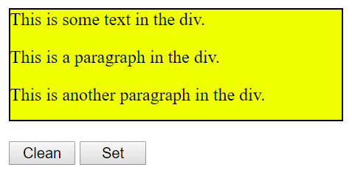
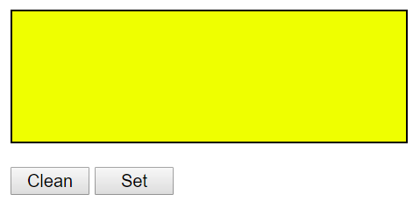
jQuery : Exercice 2
Notes:
<!DOCTYPE html>
<html>
<head>
<script src="https://ajax.googleapis.com/ajax/libs/jquery/1.7.2/jquery.min.js"></script>
<script>
$(document).ready(function(){
var taillePoliceInitiale = $('p').css('fontSize');
$('p').click(function(){
if( $(this).css('fontSize') != '100px' ){
$(this).css('fontSize', '100px');
} else {
$(this).css('fontSize', taillePoliceInitiale);
}
});
});
</script>
</head>
<body>
<p style="font-size: 50px;">Mon texte qui s'agrandit</p>
</body>
</html>

Slide 28
jQuery : Corrigé 2
<!DOCTYPE html>
<html>
<head>
<script src="https://ajax.googleapis.com/ajax/libs/jquery/3.4.1/jquery.min.js"></script>
<script>
$(document).ready(function() {
var html = $("#div1").html();
$("#btn1").click(function() {
$("#div1").empty();
});
$("#btn2").click(function() {
$("#div1").html(html);
});
});
</script>
</head>
<body>
<div id="div1"
style="height: 100px; width: 300px; border: 1px solid black; background-color: yellow;">
This is some text in the div.
<p>This is a paragraph in the div.</p>
<p>This is another paragraph in the div.</p>
</div><br>
<button id="btn1" style="width: 60px;">Clean</button>
<button id="btn2" style="width: 60px;">Set</button>
</body>
</html>

Slide 29
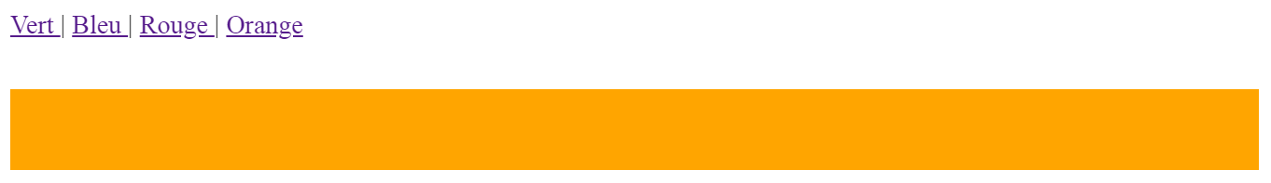
jQuery : Exercice 2
Créez 4 boutons et un rectangle. Chaque bouton provoque une action sur le rectangle.
Bouton 1 : met le rectangle en vert
Bouton 2 : met le rectangle en bleu
Bouton 3 : met le rectangle en rouge
Bouton 4 : met le rectangle en orange
Notes:
<html>
<head>
<script src="https://ajax.googleapis.com/ajax/libs/jquery/1.7.2/jquery.min.js"></script>
<script>
$(document).ready(function(){
couleurInitiale = $('#rectangle').css('backgroundColor');
$('#bouton1').click(function(){
if( $('#rectangle').height() < 100 ) {
$('#rectangle').css('height', $('#rectangle').height()+10+"px");
} else {
$('#rectangle').css('height', '10px');
}
});
$('#bouton2').click(function(){
$('#rectangle').css('backgroundColor', 'green');
});
$('#bouton3').click(function(){
$('#rectangle').css('backgroundColor', couleurInitiale);
});
$('#bouton4').click(function(){
$('#rectangle').css('display', 'none');
});
$('#bouton5').click(function(){
$('#rectangle').css('display', 'block');
});
});
</script>
<style>
#rectangle { background:#356188; height:50px; margin-top:30px; }
</style>
</head>
<body>
<a href="#" id="bouton1">Bouton 1</a>
<a href="#" id="bouton2">Bouton 2</a>
<a href="#" id="bouton3">Bouton 3</a>
<a href="#" id="bouton4">Bouton 4</a>
<a href="#" id="bouton5">Bouton 5</a>
<div id="rectangle"></div>
</body>
</html>

Slide 30
jQuery : Corrigé 2
<!DOCTYPE html>
<html>
<head>
<script src="https://ajax.googleapis.com/ajax/libs/jquery/3.3.1/jquery.min.js"></script>
<script>
$(document).ready(function(){
var couleurInitiale = $('#rectangle').css('backgroundColor');
$('#bouton1').click(function(){ $('#rectangle').css('backgroundColor', 'green'); });
$('#bouton2').click(function(){ $('#rectangle').css('backgroundColor', 'blue'); });
$('#bouton3').click(function(){ $('#rectangle').css('backgroundColor', 'red'); });
$('#bouton4').click(function(){ $('#rectangle').css('backgroundColor', couleurInitiale); });
});
</script>
<style> #rectangle { background:orange; height:50px; margin-top:30px; } </style>
</head>
<body>
<a href="#" id="bouton1">Vert </a> |
<a href="#" id="bouton2">Bleu </a> |
<a href="#" id="bouton3">Rouge </a> |
<a href="#" id="bouton4">Orange</a>
<div id="rectangle"></div>
</body>
</html>

Slide 31
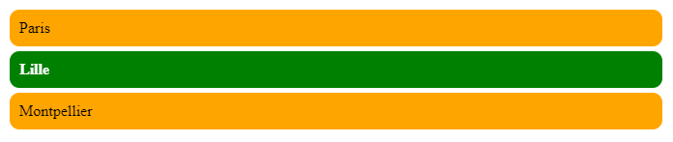
jQuery : Exercice 3
Créez une liste d’éléments. L’élément sélectionné change de style.
NB : Lorsque on clique sur un élément, tous les éléments reprennent le style de initial, hormis l’élément courant.
En gros, il faut faire en sorte que quand on clique sur un <li>, on mette une classe "active" sur le <li>. Pour ajouter une classe, on peut utiliser addClass(), pour en retirer une, removeClass().
Notes:
<html>
<head>
<script src="https://ajax.googleapis.com/ajax/libs/jquery/1.7.2/jquery.min.js"></script>
<script>
$(document).ready(function(){
couleurInitiale = $('#rectangle').css('backgroundColor');
$('#bouton1').click(function(){
if( $('#rectangle').height() < 100 ) {
$('#rectangle').css('height', $('#rectangle').height()+10+"px");
} else {
$('#rectangle').css('height', '10px');
}
});
$('#bouton2').click(function(){
$('#rectangle').css('backgroundColor', 'green');
});
$('#bouton3').click(function(){
$('#rectangle').css('backgroundColor', couleurInitiale);
});
$('#bouton4').click(function(){
$('#rectangle').css('display', 'none');
});
$('#bouton5').click(function(){
$('#rectangle').css('display', 'block');
});
});
</script>
<style>
#rectangle { background:#356188; height:50px; margin-top:30px; }
</style>
</head>
<body>
<a href="#" id="bouton1">Bouton 1</a>
<a href="#" id="bouton2">Bouton 2</a>
<a href="#" id="bouton3">Bouton 3</a>
<a href="#" id="bouton4">Bouton 4</a>
<a href="#" id="bouton5">Bouton 5</a>
<div id="rectangle"></div>
</body>
</html>

Slide 32
jQuery : Corrigé 3 (1)
<!DOCTYPE html>
<html>
<head>
<style>
li{
list-style:none;
padding:10px;
margin-top:5px;
background-color:orange;
border-radius:10px;width:50%;
}
.active {
color: white;
background-color:green;
font-weight: bold;
}
</style>
</head>
Notes:
<!DOCTYPE html>
<html>
<head>
<script src="https://ajax.googleapis.com/ajax/libs/jquery/3.3.1/jquery.min.js"></script>
<script>
$(document).ready(function(){
$('li').click(function(){
$('ul li').removeClass('active');
$(this).addClass('active');
});
});
</script>
<style>
li{list-style:none; padding:10px;margin-top:5px; background-color:orange; border-radius:10px;width:50%;
}
.active { color: white; background-color:green;font-weight: bold;}
</style>
</head>
<body>
<ul>
<li>Paris</li>
<li>Lille</li>
<li>Montpellier</li>
</ul>
</body>
</html>

Slide 33
jQuery : Corrigé 3 (2)
<body>
<ul>
<li>Paris</li>
<li>Lille</li>
<li>Montpellier</li>
</ul>
<script src="https://ajax.googleapis.com/ajax/libs/jquery/3.3.1/jquery.min.js"></script>
<script>
$(document).ready(function(){
$('li').click(function(){
$('ul li').removeClass('active');
$(this).addClass('active');
});
});
</script>
</body>
</html>
Notes:
<!DOCTYPE html>
<html>
<head>
<script src="https://ajax.googleapis.com/ajax/libs/jquery/3.3.1/jquery.min.js"></script>
<script>
$(document).ready(function(){
$('li').click(function(){
$('ul li').removeClass('active');
$(this).addClass('active');
});
});
</script>
<style>
li{list-style:none; padding:10px;margin-top:5px; background-color:orange; border-radius:10px;width:50%;
}
.active { color: white; background-color:green;font-weight: bold;}
</style>
</head>
<body>
<ul>
<li>Paris</li>
<li>Lille</li>
<li>Montpellier</li>
</ul>
</body>
</html>

Slide 34
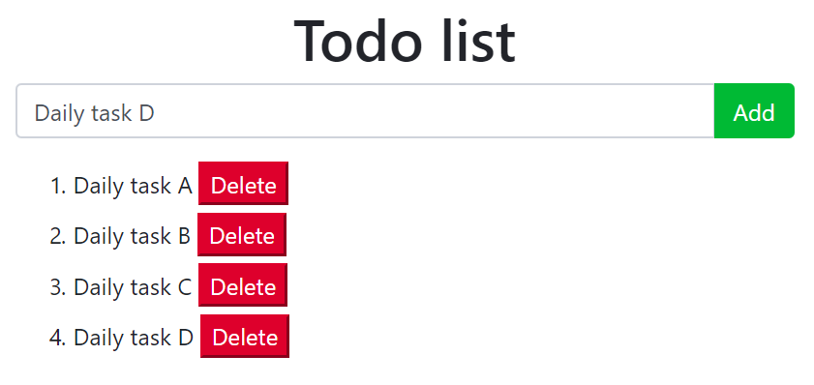
jQuery : Exercice 4
Notes:
<html>
<head>
<script src="https://ajax.googleapis.com/ajax/libs/jquery/1.7.2/jquery.min.js"></script>
<script>
$(document).ready(function(){
couleurInitiale = $('#rectangle').css('backgroundColor');
$('#bouton1').click(function(){
if( $('#rectangle').height() < 100 ) {
$('#rectangle').css('height', $('#rectangle').height()+10+"px");
} else {
$('#rectangle').css('height', '10px');
}
});
$('#bouton2').click(function(){
$('#rectangle').css('backgroundColor', 'green');
});
$('#bouton3').click(function(){
$('#rectangle').css('backgroundColor', couleurInitiale);
});
$('#bouton4').click(function(){
$('#rectangle').css('display', 'none');
});
$('#bouton5').click(function(){
$('#rectangle').css('display', 'block');
});
});
</script>
<style>
#rectangle { background:#356188; height:50px; margin-top:30px; }
</style>
</head>
<body>
<a href="#" id="bouton1">Bouton 1</a>
<a href="#" id="bouton2">Bouton 2</a>
<a href="#" id="bouton3">Bouton 3</a>
<a href="#" id="bouton4">Bouton 4</a>
<a href="#" id="bouton5">Bouton 5</a>
<div id="rectangle"></div>
</body>
</html>

Slide 35
jQuery : Corrigé 4
<!DOCTYPE html>
<html>
<head>
<link rel="stylesheet" href="https://maxcdn.bootstrapcdn.com/bootstrap/4.3.1/css/bootstrap.min.css">
<style>
li{
margin-bottom:5px;
}
</style>
</head>
<body>
<div class="container" style="margin-top:30px;">
<h1 align=center>Todo list</h1>
<div class="input-group mb-3">
<input type="text" class="form-control" placeholder="Add task" id="todo">
<div class="input-group-append">
<button class="btn btn-success" type="submit" id="todo-add">Add</button>
</div>
</div>
<ol></ol>
</div>
Notes:
<!DOCTYPE html>
<html>
<head>
<script src="https://ajax.googleapis.com/ajax/libs/jquery/3.3.1/jquery.min.js"></script>
<script>
$(document).ready(function(){
$('li').click(function(){
$('ul li').removeClass('active');
$(this).addClass('active');
});
});
</script>
<style>
li{list-style:none; padding:10px;margin-top:5px; background-color:orange; border-radius:10px;width:50%;
}
.active { color: white; background-color:green;font-weight: bold;}
</style>
</head>
<body>
<ul>
<li>Paris</li>
<li>Lille</li>
<li>Montpellier</li>
</ul>
</body>
</html>

Slide 36
jQuery : Corrigé 4
<script src="https://ajax.googleapis.com/ajax/libs/jquery/3.3.1/jquery.min.js"></script>
<script>
function remove(){
$(".btn-danger").click(function(){
$(this).parent().remove();
$(this).remove();
});
}
$(document).ready(function() {
$("#todo-add").click(function() {
var task = $("#todo").val();
$("ol").append("<li>"+task+" <button onclick='remove()'
class='btn-danger'>Delete</button></li>");
});
});
</script>
</body>
</html>
Notes:
<!DOCTYPE html>
<html>
<head>
<script src="https://ajax.googleapis.com/ajax/libs/jquery/3.3.1/jquery.min.js"></script>
<script>
$(document).ready(function(){
$('li').click(function(){
$('ul li').removeClass('active');
$(this).addClass('active');
});
});
</script>
<style>
li{list-style:none; padding:10px;margin-top:5px; background-color:orange; border-radius:10px;width:50%;
}
.active { color: white; background-color:green;font-weight: bold;}
</style>
</head>
<body>
<ul>
<li>Paris</li>
<li>Lille</li>
<li>Montpellier</li>
</ul>
</body>
</html>

Slide 37
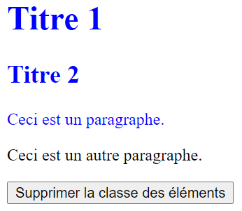
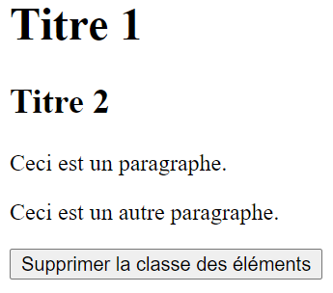
jQuery : Exercice 5
Avant le click
Après le click
Notes:
<html>
<head>
<script src="https://ajax.googleapis.com/ajax/libs/jquery/1.7.2/jquery.min.js"></script>
<script>
$(document).ready(function(){
couleurInitiale = $('#rectangle').css('backgroundColor');
$('#bouton1').click(function(){
if( $('#rectangle').height() < 100 ) {
$('#rectangle').css('height', $('#rectangle').height()+10+"px");
} else {
$('#rectangle').css('height', '10px');
}
});
$('#bouton2').click(function(){
$('#rectangle').css('backgroundColor', 'green');
});
$('#bouton3').click(function(){
$('#rectangle').css('backgroundColor', couleurInitiale);
});
$('#bouton4').click(function(){
$('#rectangle').css('display', 'none');
});
$('#bouton5').click(function(){
$('#rectangle').css('display', 'block');
});
});
</script>
<style>
#rectangle { background:#356188; height:50px; margin-top:30px; }
</style>
</head>
<body>
<a href="#" id="bouton1">Bouton 1</a>
<a href="#" id="bouton2">Bouton 2</a>
<a href="#" id="bouton3">Bouton 3</a>
<a href="#" id="bouton4">Bouton 4</a>
<a href="#" id="bouton5">Bouton 5</a>
<div id="rectangle"></div>
</body>
</html>

Slide 38
jQuery : Corrigé 5
<!DOCTYPE html>
<html>
<head>
<script src="https://ajax.googleapis.com/ajax/libs/jquery/3.5.1/jquery.min.js"></script>
<script>
$(document).ready(function(){
$("button").click(function(){
$("h1, h2, p").removeClass("blue");
});
});
</script>
<style>
.blue {
color: blue;
}
</style>
</head>
<body>
<h1 class="blue">Titre 1</h1>
<h2 class="blue">Titre 2</h2>
<p class="blue">Ceci est un paragraphe.</p>
<p>Ceci est un autre paragraphe.</p>
<button>Supprimer la classe des éléments</button>
</body>
</html>
Notes:
<html>
<head>
<script src="https://ajax.googleapis.com/ajax/libs/jquery/1.7.2/jquery.min.js"></script>
<script>
$(document).ready(function(){
couleurInitiale = $('#rectangle').css('backgroundColor');
$('#bouton1').click(function(){
if( $('#rectangle').height() < 100 ) {
$('#rectangle').css('height', $('#rectangle').height()+10+"px");
} else {
$('#rectangle').css('height', '10px');
}
});
$('#bouton2').click(function(){
$('#rectangle').css('backgroundColor', 'green');
});
$('#bouton3').click(function(){
$('#rectangle').css('backgroundColor', couleurInitiale);
});
$('#bouton4').click(function(){
$('#rectangle').css('display', 'none');
});
$('#bouton5').click(function(){
$('#rectangle').css('display', 'block');
});
});
</script>
<style>
#rectangle { background:#356188; height:50px; margin-top:30px; }
</style>
</head>
<body>
<a href="#" id="bouton1">Bouton 1</a>
<a href="#" id="bouton2">Bouton 2</a>
<a href="#" id="bouton3">Bouton 3</a>
<a href="#" id="bouton4">Bouton 4</a>
<a href="#" id="bouton5">Bouton 5</a>
<div id="rectangle"></div>
</body>
</html>

Slide 39
jQuery : Ajax
<!DOCTYPE html>
<head>
<script src="https://code.jquery.com/jquery-3.5.1.min.js"></script>
<script>
$(document).ready(function(){
/*
$.ajax({
type: "GET",
url: 'http://localhost/api-php-jquery/test.php',
success: function(data){
console.log(data);
}
});
*/
$.ajax({
type: "POST",
url: 'http://localhost/api-php-jquery/test.php',
data: {firstname: 'Wayne', lastname: 'Wayne'},
success: function(data){
console.log(data);
}
});
});
</script>
</head>
<body>
Notes:
<html>
<head>
<script src="https://ajax.googleapis.com/ajax/libs/jquery/1.7.2/jquery.min.js"></script>
<script>
$(document).ready(function(){
couleurInitiale = $('#rectangle').css('backgroundColor');
$('#bouton1').click(function(){
if( $('#rectangle').height() < 100 ) {
$('#rectangle').css('height', $('#rectangle').height()+10+"px");
} else {
$('#rectangle').css('height', '10px');
}
});
$('#bouton2').click(function(){
$('#rectangle').css('backgroundColor', 'green');
});
$('#bouton3').click(function(){
$('#rectangle').css('backgroundColor', couleurInitiale);
});
$('#bouton4').click(function(){
$('#rectangle').css('display', 'none');
});
$('#bouton5').click(function(){
$('#rectangle').css('display', 'block');
});
});
</script>
<style>
#rectangle { background:#356188; height:50px; margin-top:30px; }
</style>
</head>
<body>
<a href="#" id="bouton1">Bouton 1</a>
<a href="#" id="bouton2">Bouton 2</a>
<a href="#" id="bouton3">Bouton 3</a>
<a href="#" id="bouton4">Bouton 4</a>
<a href="#" id="bouton5">Bouton 5</a>
<div id="rectangle"></div>
</body>
</html>

